Slide 1

Data Science project: Aphasia
KB-74
Notes:
We want to start off with an example of our progress in our team, we did get some knowledge from datacamp and coursera .

Slide 2
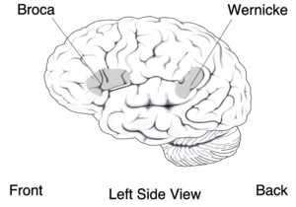
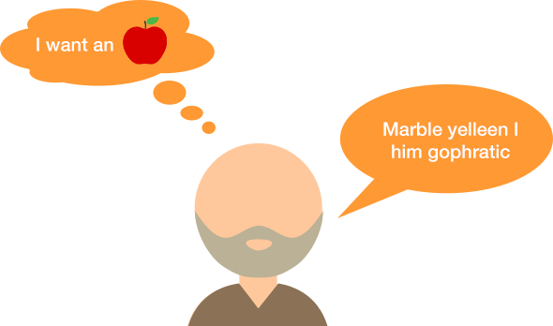
Aphasia
speech to text
Goal of the project: Create a speech to text software that can successful translate speech from aphasia patients.

Slide 3
Content
Cleaning data
Trained models
Sphinx results
Problems
Future
Notes:
We want to start off with an example of our progress in our team, we did get some knowledge from datacamp and coursera .

Slide 4
Data cleaning
Uva
Scraper script 🗹
Reforming text script 🗹
Audio and text aligner 🗹
Creating dataset for using sphinx 🗹
Notes:
We want to start off with an example of our progress in our team, we did get some knowledge from datacamp and coursera .

Slide 5
3 Models
Sphinx dictionary
Acoustic model
Langue Model
Sentences in <s> tags
Correct audiofragment
Word -> phoneme
Dictionary of words.
With sentences

Slide 6
Sphinx results
Good results for word that are in the dictionary
Can predict words outside of the dictionary.
Cant detect the nonsense.
Notes:
st

Slide 7
Problems
Own dataset is not big enough Sphinx(1.4M/ 6k)
No insight in the phonemes
Want insight nonsense

Slide 8
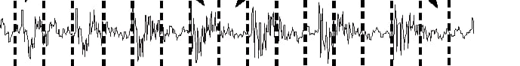
Future Work
Classifier phoneme boundary(RCN/LSTM/etc)
Generate diphones with related labels
Dictionary with related labels
Map2Voc - to map diphones to words
HMM for correction of translation errors in words.

